Slide 1
MLOPSDatabank 1.0 Feature Deck
TEAM DATA BANK
Presenter:
Omkar Sonar
Chetan Yadav
18-08-2022

Slide 2
Index
INTRODUCTION TO DATABANK
FEATURE DECK
FUTURE ROAD MAP

Slide 3
Introduction to Data Bank
Any Machine learning Projects needs huge amount of data for training the Models
To facilitate the continuous demand of data for labelling and model training, Data Bank was started 1.5 years back.
Nextgen ADR and Nextgen ADE have utilized 55,39,043 and 13,77,159 respectively amount of data in past 1.5 Years.
Initial task of Data Bank was to acquire the data from production site and provide it ML team for preprocessing & post processing further transferring to A51.
Issues with labelImg were increasing hence AIQ was brought into picture
Data bank team took the responsibility for setting up the entire data pipeline for using AIQ for labelling process
This pipeline consisted of 30+ manual steps starting from Data acquisition (i.e., downloading from production site) through preprocessing, Uploading in AIQ, Several Renaming and Classifying documents further till Post Processing until transferring to A51 and confirming the data transfer in A51 using data bricks
Team had to overcome several challenges and limitations not limiting to :
Managing Knowhow: Cumbersome KT process of 30+ manual steps to every new member
Tracking Activity: Reports had to be generated manually, daily, by consolidating the numbers from each team member
Tracking Documents: The document reached at Machine Learning had to trace back to its origin, the link between raw and processed was never established.
Unorganized Storage: Documents were lying wherever the space was found, across drives, across VMs and across Users.

Slide 4
How Automation Works
Enable Decryption
MongoDB
Jira ID
Arrives
Create
Environment
Entry in Jira Master Table
Enable PreClassification
MongoDB
Enable PreRenaming
MongoDB
JiraID_dwndt_strtdt_enddt
Folder structure
As per Pipeline selected
JiraID Config
Configuration file
Enable UploadtoAIQ
MongoDB
Enable ADR A51 Transfer
MongoDB
Daily Snapshot
Workable InvalidatedXML
MongoDB
MySQL – ETL
Source – Stagging – Transformations
Tables, Views, Stored Procedures
Workable Post Classification
MongoDB
Workable Post Renaming
MongoDB
Workable Postprocessing
MongoDB

Slide 5
Feature Deck

Slide 6

Ease of Setup and Maintenance
Isolated and Independent Resources for Data Processing
Configuration Driven Framework
Single Parameter Process Executions
Setup
Jira Config
ADR
Central Config
Data Bank Location
MongoDB
Inventory
Jira Config
ADE
Jira Config
MySQL
Just JIRA ID
Dedicated Workspace Per JIRA Ticket
ADE
ADS-1111
Workspace
ADS-2222
Workspace
Data Bank
Config Linked Jira ID based directory
Documents and Processes
Setup Scripts
Pipeline Scripts
Process Scripts
Setup and Snapshot Scripts

Slide 7
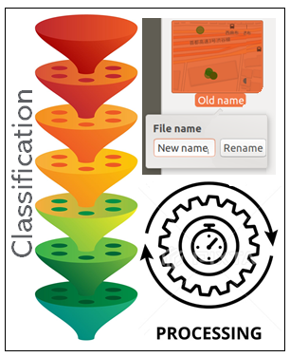
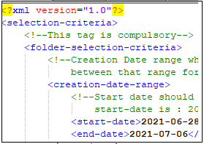
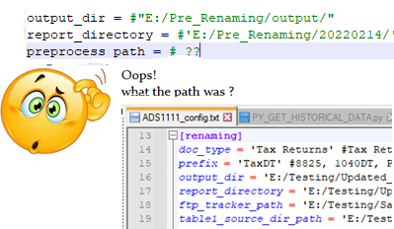
Less Manual Intervention
Manual Operations
Converted to Automation
Metadata read from Criteria Files
File Paths framed automatically for entire Data Bank Operations

Slide 8
Process High Volume of Data
Data Bank Repository
Scripts | Tools | Configuration
Data Bank
On VM
Data Bank on AWS
MySQL
MongoDB
Data Bank on qumsfs
Multiple Document
Multiple Sites
Multiple Jira Requests
Multiple Processes
Parallel Executions from multiple locations, multiple users – with centralized data base and tracking

Slide 9
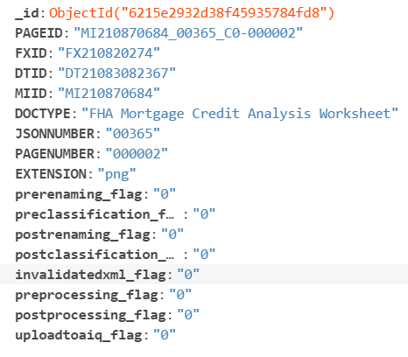
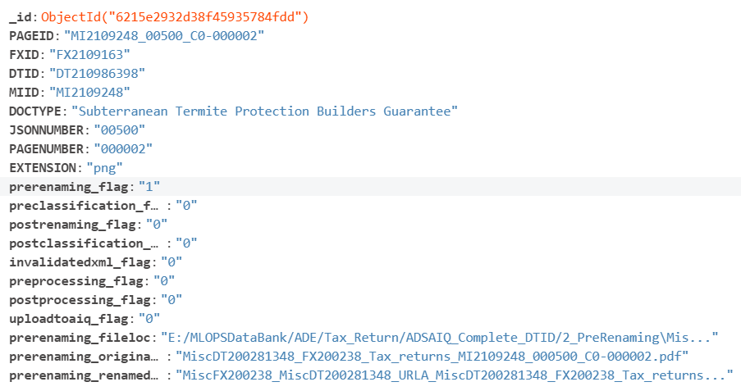
Document Tracking and Recovery
Second page, on which the pre-renaming process was executed, but others process are yet to be started.
With each completed process, the flags will be set ON and relevant information will be added
First Page which is initiated and
unprocessed

Slide 10
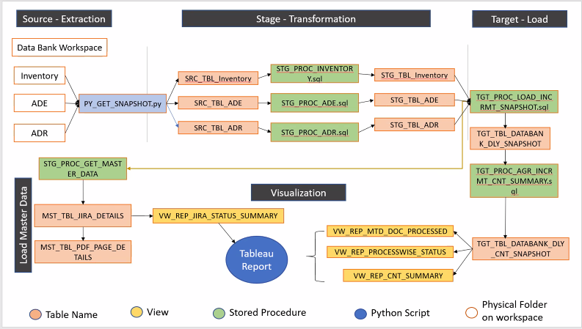
Data Analytics

Slide 11

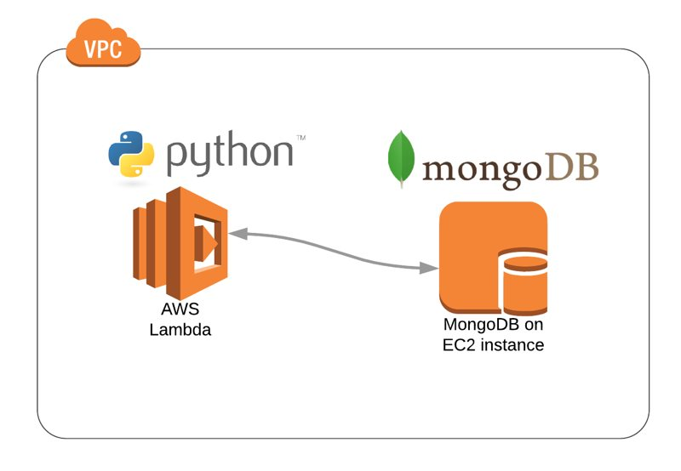


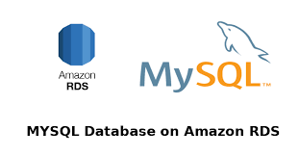

Scalable Cloud based Architecture
MySQL
MongoDB
DATA
SCIENCE
REPORTS
&
INSIGHTS
Python
Understanding the exponential data growth in Databank
Avg no. of Jira tickets in month: 7
Avg size of production data getting downloaded per Jira : 100 GB ( ranging from 10 GBs to 500 GB )
Data holding period: 30 days
Big Advantages of having ML and Databank on Same platform
Currently only limited and submitted Documents are used for predicting labels.
Entire track records of Document can add to multiple insights, flexibility of document usage and asynchronous document access for machine learning. No manual dependency on Data Bank team.
Readily available different versions of documents from Databank can be used for several purpose such as MDM, ML etc. whatever you may think off.
Effective DevOps → Advanced Security → Calculated Expansion → Wider Scope

Slide 12
Think Automation way

Slide 13
Databank Mind Map – Step 1 Inventory
But I need only subset to label
What do we want?
What to do then ?
What do I have ?
Data Science team needs some documents
Documents must be downloaded from Prod
I have Jira request to define qty, range
and Document Type
Download and keep the data at once, and upload only what's needed
Relax and sit back and wait for next Jira request to upload the document to AIQ, process it and then transfer to Area51
No worries, the data bank pipeline will bucketize the documents and keep documents separately type wise
Download data, preprocess it , keep it classified if required and store in Databank Inventory
Now what next ?
But if I have multiple doctype in same Jira
What's the process ?

Slide 14
Databank Mind Map – Step 2 ADE
But I do not need all downloaded documents
What if its already downloaded
What do we want?
What to do then ?
Data Science team wants labelled documents for ADE
Check if we have already downloaded the set
Give us a Jira ticket, we will fetch the documents from Inventory
No problem, paste only those many documents which you wish to label
Just continue with the process using automation scripts. Upload to AIQ, download from AIQ and take it to Area51
Create the setup under the Jira ticket and let the structure get created. The configurations will be created automatically.
It won’t. they are linked with MongoDB analytics. Once processed, the document will not get processed again
Ok, what next ?
Where do I start ?
But what if the documents get repeated ?

Slide 15
Databank Mind Map – Step 3 Analytics
What if the same document is processed once again
How to status of daily pipeline executions ?
How do we know which documents are processed
What after executing the automation ?
We need to run the Snapshot script to take the Near real time image of databank
The moment we run automation script, the files touched makes an update in Mongo Db, to mark its attendance
It won't be allowed. It will check for its flag in MongoDB. If its marked present, then document will be skipped from processing
Look for the documents in file system and traces in MongoDB
Keep a watch on databank activity without asking for a status from engineers or manager. Everything is transparent.
Snapshot will have all entries which are present on file systems grouped by site name, doc type, Jira tickets, processes & IDs. We can take any report out from here
It can be taken any time, but taking it after a pipeline activity makes since, as it will add certain information to the report
Ok, what next ?
How frequently a snapshot can be taken ?
Ok, what will the snapshot help ?

